Slide 1
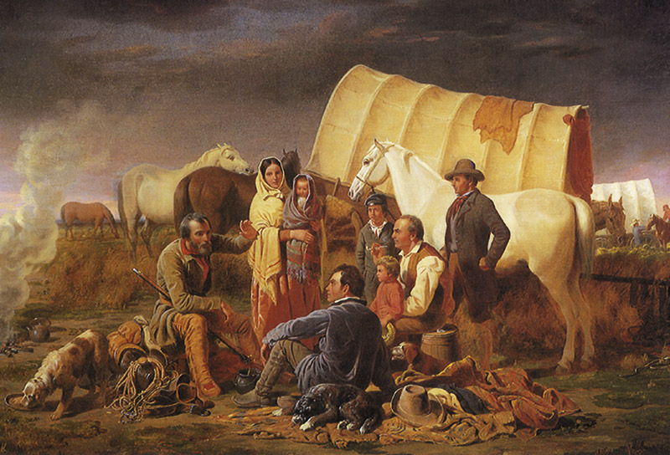
The Consolidation of the Republic
Overview
1789 - 1849

Slide 2
The New Nation
Following the Revolutionary War the new American nation faced many challenges:
With a partner take 2 minutes and make a list of challenges the new American nation faced following the Revolutionary War.
Western Expansion?
Government Structure?
Trade Relations?
France, Britain, Spain…
State Tensions

Slide 3
The Key Themes
Time Period
1789 to 1849
Themes:
1
Continual evolution of democratic government
Conflict with other nations
Expanding the nation
Interaction between Natives and Americans
2
3
4

Slide 4
Inter-war Developments
The Presidency of George Washington
Declining Relations with the French
Difficulties with Britain
The War of 1812
The Era of Good Feelings
Westward Expansion
Manifest Destiny
War with Mexico

Slide 5
George Washington
George Washington was, of course, the first American President. Some of his accomplishments:
He served two terms in office from 1789 to 1797.
Helped establish the different branches of gov’t.
Dealt with the “Whiskey Rebellion” of 1794.
Sought to avoid the development of political parties.

Slide 6
Declining Relations with the French
The French felt their assistance to the Americans during the revolution would be rewarded.
Instead the Americans formed treaties and trade relationships with the British.
The French navy seized 300 American ships and ordered the Americans to pay 12 million dollars in tribute. (XYZ Affair)
The Americans refused and a series of naval battles took place until a compromise was reached.

Slide 7
The Louisiana Purchase of 1803
In 1803 the Americans, led by President Thomas Jefferson, purchased “Louisiana” from the French (previously Spanish territory).
The cost was 15 million dollars or roughly 4 cents per acre.
The land acquisition doubled the size of the USA and opened the west to expansion and exploration.

Slide 8
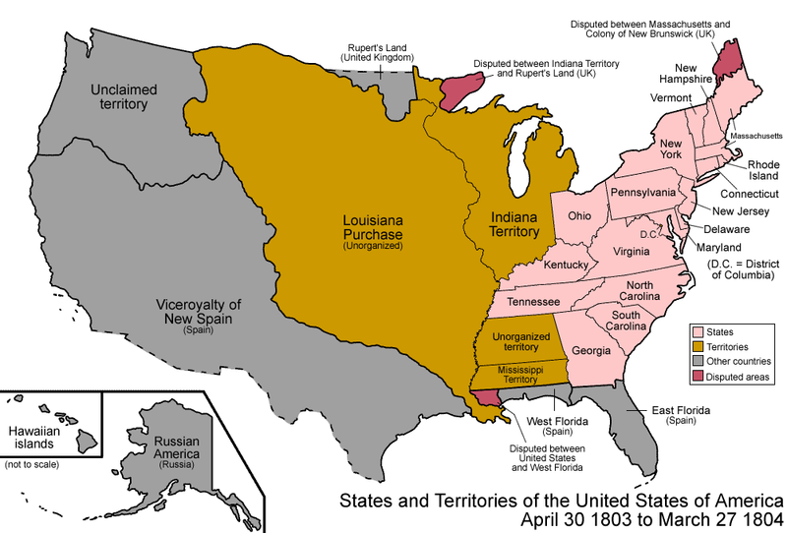
The Louisiana Purchase in 1803

Slide 9
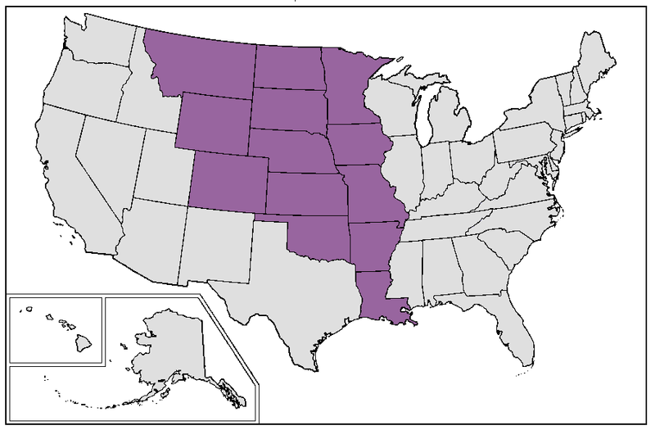
Louisiana Purchase Today

Slide 10
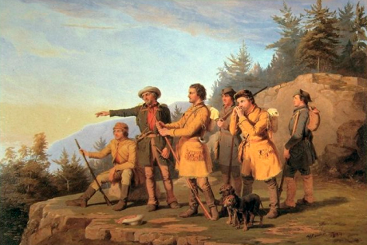
Westward Expansion
Following the Louisiana Purchase of 1803, the American nation continued to expand westward.
The American government adopted a philosophy called: Manifest Destiny
The American nation was “destined” to control all of North America

Slide 11
Lewis and Clarke
Commissioned by President Jefferson, Lewis and Clarke explored the Pacific Northwest.
Leaving from St. Louis in 1804, they travelled westward with the aid of a native guide named, “Sacajawea.”
Go the website:
the-map-as-history.com
Using the login information provided by your teacher watch the map animation:
“The Lewis and Clarke Expedition.”

Slide 12
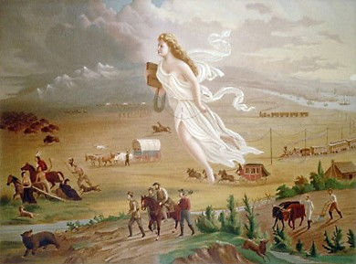
How is Manifest Destiny symbolized in this artwork?

Slide 13
Difficulties with Britain
War soon broke out between France and Britain in 1803.
The Americans exported to both sides.
The British defeated the French navy at the Battle of Trafalgar .
Following the war the British imposed a loose blockade of American ports thereby crippling American trade and imposed impressment on American sailors.

Slide 14
The War of 1812
In response, the Americans declared war on the British.
The war was most supported by the West and South, but not New England.
Battles took place from New Orleans to Lake Erie.
In the end nothing was gained by either side.
A final treaty (Ghent) was signed in 1815.

Slide 15
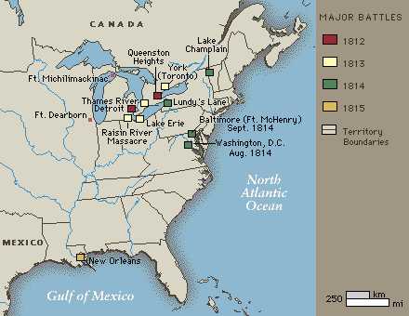
War of 1812: Regions Involved

Slide 16
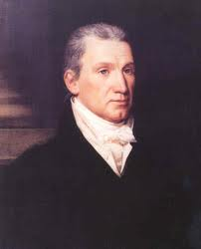
The Era of Good Feelings
Following the War of 1812 a growing sense of nationalism began to take root among the American states.
National heroes began to emerge (Davey Crockett), along with tales of exploration and symbols of unity (Star Spangled Banner).
James Monroe

Slide 17
War with Mexico
War started with Mexico in 1846.
Unable to withstand American attacks, the Mexicans surrendered in 1848.
The Americans gained the territories:
Texas, California, Arizona, Nevada, Colorado, Utah and New Mexico
Notes:
Gadsden 1853

Slide 18
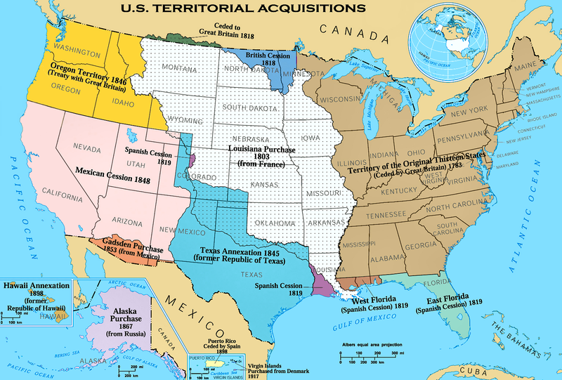
Westward Expansion

Slide 19
Conclusion
The interwar period was a time of tremendous growth for Americans not only territorially, but also in the areas of political stability, patriotism and foreign relations.
However, new challenges would soon arise with the coming crisis – the Civil War.

